Slide 1
Data Integration, Data Warehousing, and Entity Resolution
Nicholas Mattei, Tulane University
CMPS3660 – Introduction to Data Science – Fall 2019
https://rebrand.ly/TUDataScience
Many Thanks
Slides based off Introduction to Data Science from John P. Dickerson - https://cmsc320.github.io/

Slide 2
Announcements
Milestone 1 Recap
Milestone 2 is Out!
Lab 6+7 Recap
Project 1 Due Tonight!

Slide 3
The Data LifeCycle
Data Collection
Data Processing
Exploratory Analysis
&
Data Visualization
Analysis, Hypothesis Testing,
& ML
Insight
&
Policy Decision
Today

Slide 4
Overview
Goal: Get data into a structured form suitable for analysis!
Variously called: data preparation, data munging, data curation.
Also often called ETL (Extract-Transform-Load) process.
Often the step where majority of time (80-90%) is spent.
Key Steps:
Scraping: extracting information from e.g., webpages, spreadsheets.
Data Transformation: to get it into the right structure.
Data Integration: combine information from multiple sources.
Information Extraction: extracting structured information from unstructured/text sources.
Data Cleaning: remove inconsistencies/errors.
Milestone 2!

Slide 5
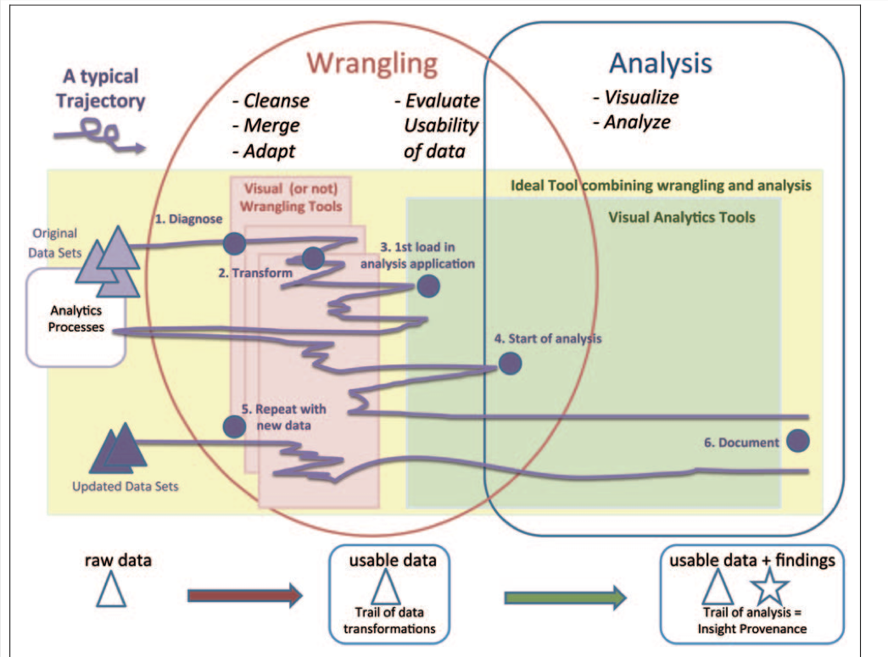
Data Science In Practice…

Slide 6
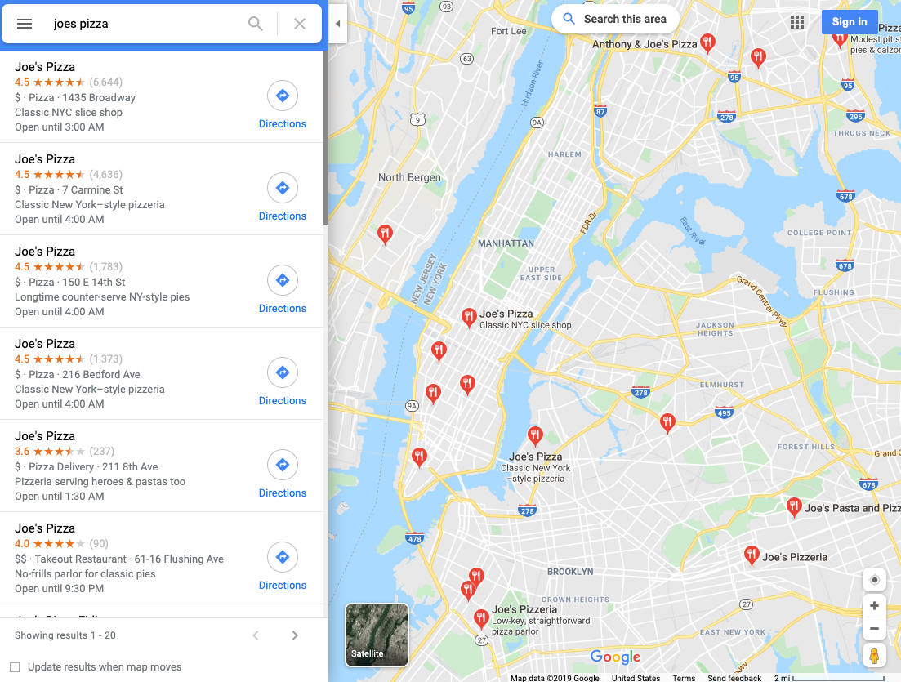
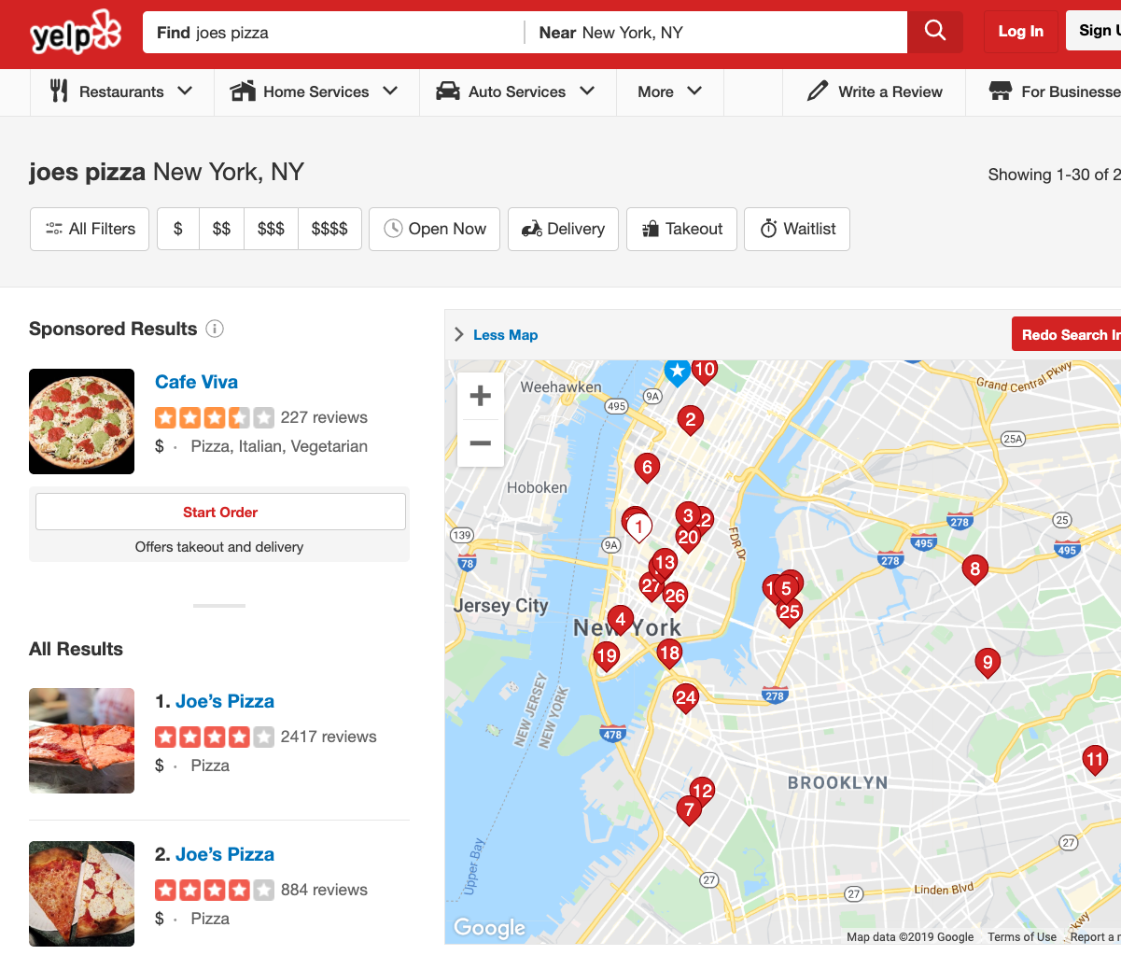

A Motivating Example
I’m back in NYC for a visit.
Pizza in New Orleans is awful, and I want Pizza.
A friend told me to go to Joe’s Pizza, because it’s the best.
Search away…

Slide 7
Not Even the Same Set!

Slide 8
Overview
Many of the problems ETL stack are hard to formalize, e.g., Data Cleaning.
Others aspects have been studied in depth, e.g., schema matching and entity resolution
VLDB Tutorial on Entity Resolution
A mish-mash of tools typically used:
Visual (e.g., Trifacta), or not (grep/sed/awk, Pandas).
Ad hoc programs for cleaning data, depending on the exact type of errors.
Different types of transformation tools.
Visualization and exploratory data analysis to understand and remove outliers/noise.
Several tools for setting up the actual pipelines, assuming the individual steps are setup (e.g., Talend, AWS Glue).

Slide 9
Outline
Data Integration
Data Quality Issues
Data Cleaning
Outlier Detection
Entity Resolution

Slide 10
A Few Words to Remember…
ID | age | wgt_kg | hgt_cm
1 | 12.2 | 42.3 | 145.1
2 | 11.0 | 40.8 | 143.8
3 | 15.6 | 65.3 | 165.3
4 | 35.1 | 84.2 | 185.8
Schema. The organization of data within a database or table.
i.e., how you data is setup in either a table or RDBMS.
Instance. A single record or element of your data.
e.g., Joe’s Pizza, our 2nd athlete.
What follows is from Data Cleaning: Problems and Current Approaches – IEEE Big Data, 2000.
Somewhat old: data is mostly coming from structured sources.
For a data scientist, the data scraping is equally important.

Slide 11
Data Integration: The Goal!
Queries
Linkage
Querying integrated information sources (e.g. queries to views, execution of web-based queries, …)
Data mining & analyzing integrated information (e.g., collaborative filtering/classification learning using extracted data, …)
Discovering information sources (e.g. web modeling, schema learning, …)
Gathering data (e.g., wrapper learning & information extraction, federated search, …)
Cleaning data (e.g., de-duping and linking records) to form a single [virtual] database

Slide 12
Data Integration
Goal: Combine data residing in different sources and provide users with a unified view of these data for querying or analysis.
Each data source has its own schema called local schemas
Most work assumes relational schemas, but some work on XML and others.
The unified schema is often called mediated schema or global schema.
Traditionally Two Approaches.
Data Warehousing: bring the data together into a single repository.
In-Place Integration: Keep the data where it is, and send queries back and forth.

Slide 13
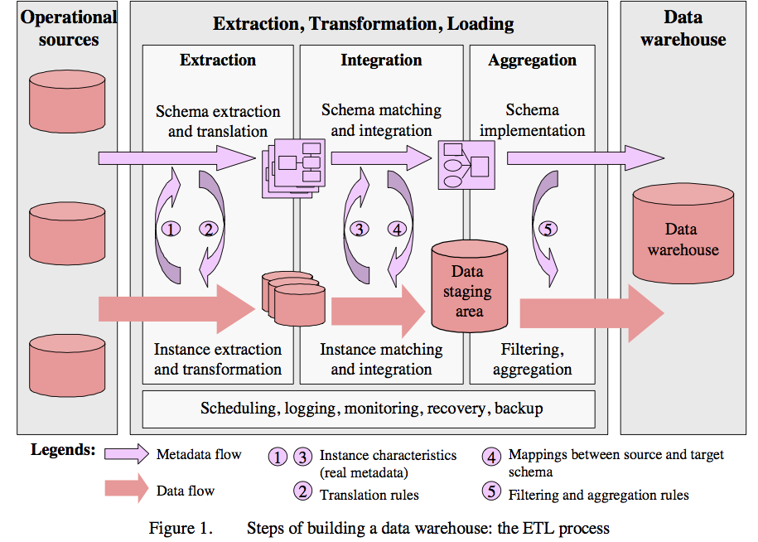
1. Data Warehousing

Slide 14
In-place Integration
Query Q
Mediated Schema
Q’
Q’
Q’
Q’
Q’
Source
Source
Source
Source
Source

Slide 15
Data Integration
Two different setups:
Data Warehousing: bring the data together into a single repository.
Relatively easier problem - only need one-way-mappings.
Query performance predictable and under your control.
Hard to integrate changes as we have to reprocess.
In-Place Integration: Keep the data where it is, and send queries back and forth.
Need two-way mappings -- a query on the mediated schema needs to be translated into queries over data source schemas.
Not as efficient and clean as data warehousing, but a better fit for dynamic data.
Or when data warehousing is not feasible.

Slide 16
Data Integration: Key Challenges
Data extraction, reconciliation, and cleaning.
Get the data from each source in a structured form.
Need to use wrappers to extract data and define local schema.
Schema alignment and mapping.
Figure out mappings / matchings between schemas.
Decide on the best mediated schema.
Answer queries over the global schema.
Decide mapping a query on global schema onto queries over local schemas
Also need to decide which sources contain relevant data
Limitations in mechanisms for accessing sources.
Many sources have limits on how you can access them!
Limits on the number of queries you can issues (say 100 per min)
Limits on the types of queries
e.g., must enter a zipcode to get information from a web source.

Slide 17
Schema Matching or Alignment
Goal: Identify corresponding elements in two schemas.
As a first step toward constructing a global schema.
Schema heterogeneity is a key roadblock.
Different data sources speak their own schema.
Hotel, Restaurant,
AdventureSports, HistoricalSites
Data Source
Consumer
Hotel, Gaststätte
Brauerei, Kathedrale
Data Source
Mediator
Data Source
Lodges, Restaurants
Beaches, Volcanoes

Slide 18
Schema Matching or Alignment
Books
Title
ISBN
Price
DiscountPrice
Edition
Authors
ISBN
FirstName
LastName
BooksAndMusic
Title
Author
Publisher
ItemID
ItemType
SuggestedPrice
Categories
Keywords
BookCategories
ISBN
Category
CDCategories
ASIN
Category
CDs
Album
ASIN
Price
DiscountPrice
Studio
Inventory
Database A
Artists
ASIN
ArtistName
GroupName
Inventory Database B

Slide 19
Summary
Data integration continues to be a very active area in research and increasingly industry.
E.g, how do we automatically extract and query open / competitor databases.
Solutions still somewhat ad hoc and manual, although tools beginning to emerge.
AWS Glue, Watson Data Pipe, etc.
Goal: minimize the time needed to integrate a new data source!
Crucial opportunities may be lost otherwise.
Can take weeks to do it properly.
Dealing with changes to the data sources a major headache.
Especially for data sources not under your control.
As Project 1 is showing you…

Slide 20
Outline
Data Integration
Data Quality Issues
Data Cleaning
Outlier Detection
Entity Resolution

Slide 21
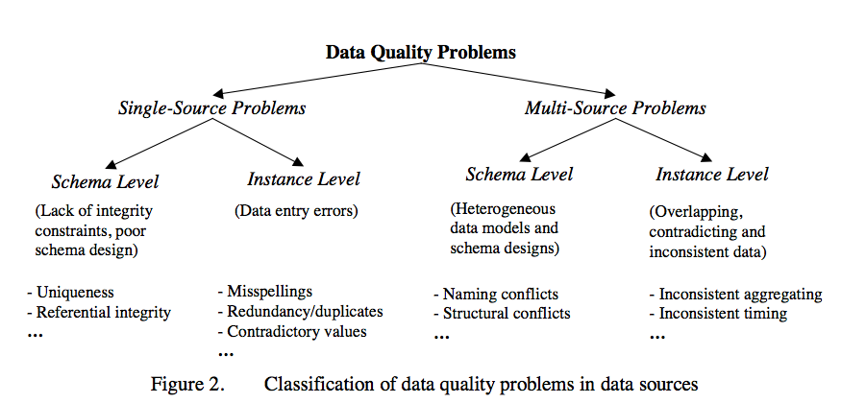
Data Quality Problems
From Data Cleaning: Problems and Current Approaches

Slide 22
Single Source Problems
Depends largely on the source – is it reliable or not?
Databases can enforce constraints, whereas data extracted from files or spreadsheets, or scraped from webpages is much more messy.
Types of Problems:
Ill-formatted data, especially from webpages or files or spreadsheets.
Missing or illegal values, Misspellings.
Use of wrong fields, Extraction issues (not easy to separate out different fields).
Duplicated records, Contradicting Information, Referential Integrity Violations.
Unclear/confusing default values.
Evolving/changing schemas or classification schemes (for categorical attributes).
Outliers.

Slide 23
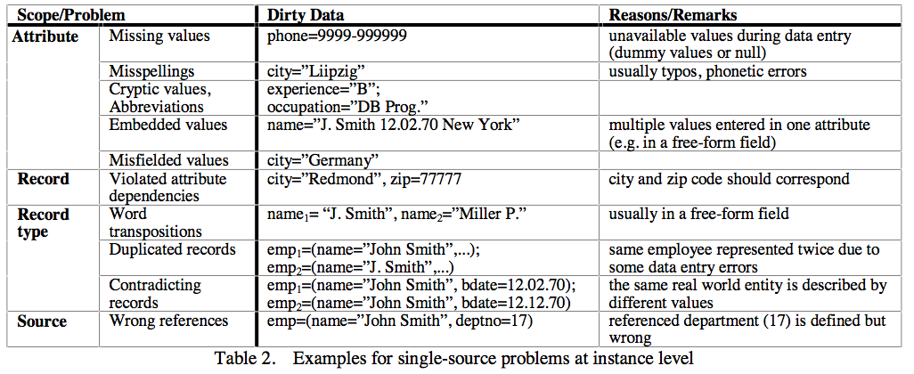
Single Source Problems

Slide 24
Multi-Source Problems
Different sources are developed separately, and maintained by different people.
Issue 1: Mapping information across sources (schema mapping/transformation).
Same issues as in data integration we saw before.
Naming conflicts: same name used for different objects.
Structural conflicts: different representations across sources.
Issue 2: Entity Resolution: Matching entities across sources!
Issue 3: Data quality issues.
Contradicting information, Mismatched information, etc.

Slide 25
Outline
Data Integration
Data Quality Issues
Data Cleaning
Outlier Detection
Entity Resolution

Slide 26
Dealing with Univariate Outliers
Set of values can be characterized by metrics: center (e.g., mean), dispersion (e.g., standard deviation), and skew.
Used to identify outliers:
Watch out for "masking": one extreme outlier may alter the metrics sufficiently to mask other outliers.
Should use robust statistics: considers effect of corrupted data values on distributions (next week!)
Robust center metrics: median, k% trimmed mean (discard lowest/highest k% values)
Robust dispersion: Median Absolute Deviation (MAD): median distance of all the values from the median value
A reasonable approach: discard any data points 1.4826x MAD away from median.
The above assumes that data follows a normal distribution.
May need to eyeball the data (e.g., plot a histogram) to decide if this is true.

Slide 27
Univariate Outliers
Wikipedia Article on Outliers lists several other normality-based tests for outliers.
If data appears to be not normally distributed:
Distance-based methods: look for data points that do not have many neighbors.
Density-based methods:
Define density to be average distance to k nearest neighbors.
Relative density = density of node/average density of its neighbors.
Use relative density to decide if a node is an outlier
Many techniques start breaking down as the dimensionality of the data increases:
Curse of dimensionality – too many different dimensions to look for outliers!
Can project data into lower-dimensional space and look for outliers there
PCA / Embeddings / Fun Machine Learning Stuff!

Slide 28
Other Types of Outliers
Timeseries outliers:
Often the data is in the form of a timeseries
Can use the historical values/patterns in the data to flag outliers.
Rich literature on forecasting in timeseries data.
Frequency-based outliers:
Item is called a "heavy hitter" if it is much more frequent than other items.
In relational tables, can be found using a simple groupby-count.
Often the volume of data may be too much (e.g., internet routers).
Approximation techniques often used.
Things generally not as straightforward with other types of data.
What about Networks, Images, or other datasets?
Outlier detection continues to be a major research area

Slide 29
Wrap-up
Data wrangling/cleaning are a key component of data science pipeline
Still largely ad hoc although much tooling in recent years
Specifically, we covered:
Schema mapping and matching
Outliers
Next up:
Constraint-based Cleaning
Entity Resolution/Record Linkage/Data Matching

Slide 30
Outline
Data Integration
Data Quality Issues
Data Cleaning
Outlier Detection
Entity Resolution

Slide 31
Data Cleaning: Entity Resolution (ER)
Content from: Entity Resolution Tutorial, VLDB 2012.
Goal: Identify different manifestations of the same real world object.
Also called: identity reconciliation, record linkage, deduplication, fuzzy matching, Object consolidation, Coreference resolution, and several others (ER has an ER problem…).
Motivating Examples ????
Postal addresses
Entity recognition in NLP/Information Extraction
Identifying companies in financial records
Comparison shopping
Author disambiguation in citation data
Connecting up accounts on online networks
Crime/Fraud Detection
Census
...

Slide 32

Data Cleaning: Entity Resolution
Important to correctly identify references.
Often actions taken based on extracted data.
Cleaning up data by entity resolution can show structure that may not be apparent before.
Challenges.
Such data is naturally ambiguous (e.g., names, postal addresses).
Abbreviations/data truncation.
Data entry errors, Missing values, Data formatting issues complicate the problem.
Heterogeneous data from many diverse sources.
No magic bullet here !!
Approaches fairly domain-specific.
Be prepared to do a fair amount of manual work.

Slide 33
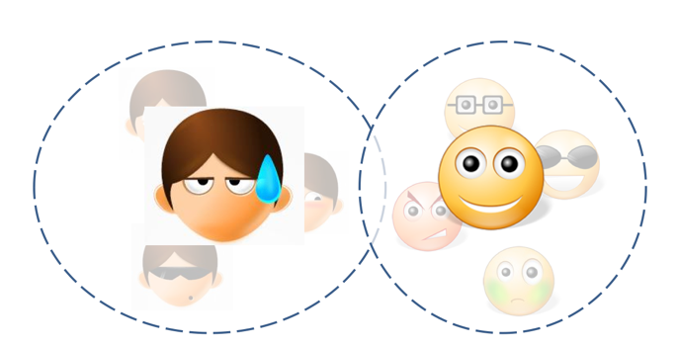
Entity Resolution: Three Slightly Different Problems
Setup.
Real world: there are entities (people, addresses, businesses).
We have a large collection of noisy, ambiguous "references" to those entities (also called "mentions").
Somewhat different techniques, but a lot of similarities.
Deduplication.
Cluster records/mentions that correspond to the same entity
Choose/construct a cluster representative
This is in itself a non-trivial task (e.g., averaging may work for numerical attributes, but what about string attributes?)

Slide 34
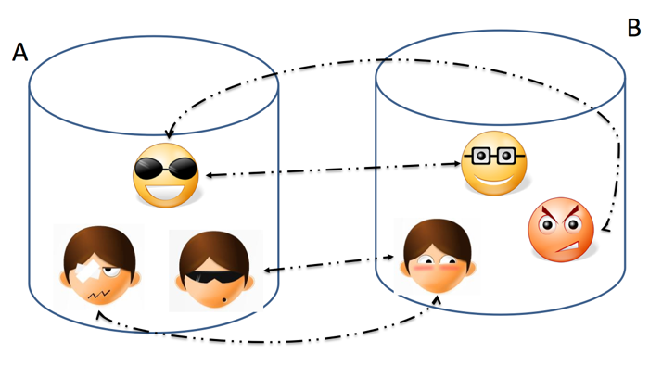
Entity Resolution: Three Slightly Different Problems
Setup.
Real world: there are entities (people, addresses, businesses)
We have a large collection of noisy, ambiguous "references" to those entities (also called "mentions")
Somewhat different techniques, but a lot of similarities.
Record Linkage.
Match records across two different databases (e.g., two social networks, or financial records w/ campaign donations).
Typically assume that the two databases are fairly clean.

Slide 35
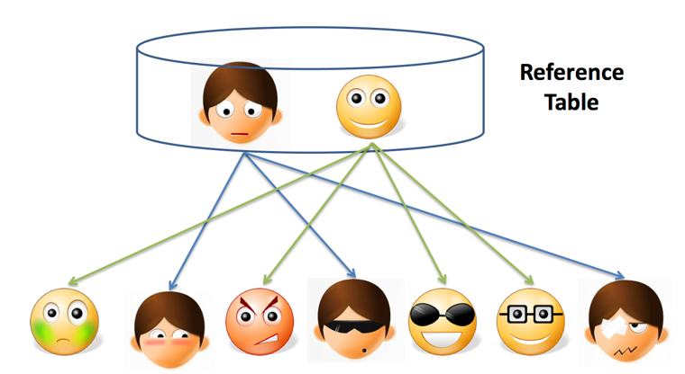
Entity Resolution: Three Slightly Different Problems
Setup.
Real world: there are entities (people, addresses, businesses)
We have a large collection of noisy, ambiguous "references" to those entities (also called "mentions")
Somewhat different techniques, but a lot of similarities.
Reference Matching.
Match "references" to clean records in a reference table.
Commonly comes up in "entity recognition" (e.g., matching newspaper article mentions to names of people).

Slide 36
Entity Resolution: Data Matching
Book Ref: Data Matching; P. Christen; 2012 (Springer).
Key issues is finding similarities between two references – but what function?
Edit Distance Functions:
Levenstein Distance. min number of changes to go from one reference to another.
Lots of variants (weights) and not cheap to compute.
Set Similarity:
Some function of intersection size and union size.
Jaccard Distance = size of intersection/size of union
Vector Similarity
Cosine similarity – we’ll talk about this much more in NLP lectures

Slide 37
Entity Resolution: Data Matching
For Words: n-grams
Find all length-n substrings in each string.
Use set/vector similarity on the resulting set.
Combine with edit-distance metrics.
May need to use Translation Tables.
To handle abbreviations, nicknames, other synonyms
Soundex: Phonetic Similarity Metric.
Homophones should be encoded the same so spelling errors can be handled, e.g., Robert and Rupert get assigned the same code (R163), but Rubin yields R150.
Different types of data requires more domain-specific functions
E.g., geographical locations, postal addresses, XML documents, etc.

Slide 38
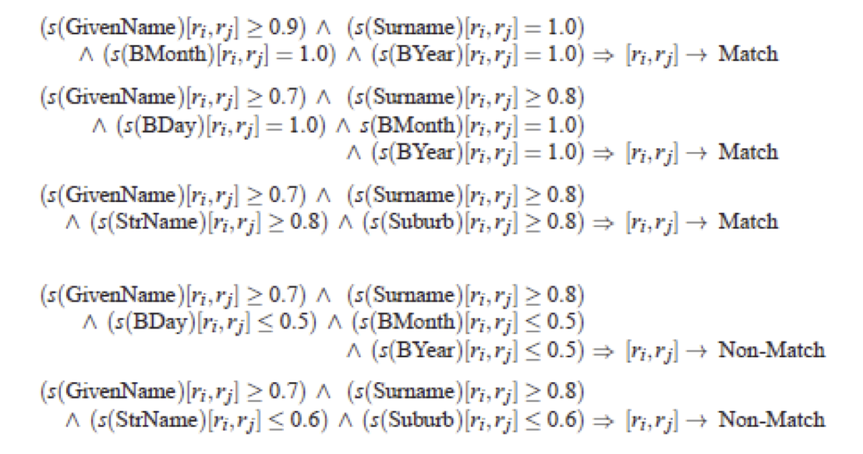
Entity Resolution: Algorithms
Threshold Method.
If the distance below some number, the two references are assumed to be equal
May review borderline matches manually
Can be generalized to rule-based:
Example from Christen, 2012

Slide 39
Entity Resolution: Algorithms
Threshold + Weights: May want to give more weight to matches involving rarer words.
More naturally applicable to record linkage problem.
If two records match on a rare name like "Machanavajjhala", they are likely to be a match.
Can formalize this as "probabilistic record linkage”.
Constraints: May need to be satisfied, but can also be used to find matches.
We often have constraints on the matching possibilities:
Transitivity: M1 and M2 match, and M2 and M3 match, and M1 and M3 must match
Exclusivity: M1 and M2 match --> M3 cannot match with M2
Other types of constraints:
E.g., if two papers match, their venues must match

Slide 40
Entity Resolution: Algorithms
Clustering-based ER Techniques.
Deduplication is basically a clustering problem.
Can use clustering algorithms for this purpose.
But most clusters are very small (in fact of size = 1).
Some clustering algorithms are better suited for this, especially Agglomerative Clustering
Unlikely K-Means would work here.

Slide 41
Entity Resolution: Algorithms
Crowdsourcing.
Humans are often better at this task.
Can use one of the crowdsourcing mechanisms (e.g., Mechanical Turk) for getting human input on the difficult pairs.
Quite heavily used commercially (e.g., to disambiguate products, restaurants, etc.).

Slide 42
Entity Resolution: Scaling to Big Data
One immediate problem – How many matches are there?
There are O(N²) possible matches!
Must reduce the search space
Use some easy-to-evaluate criterion to restrict the pairs considered further
May lead to false negative (i.e., missed matches) depending on how noisy the data is
Much work on this problem as well, but domain-specific knowledge likely to be more useful in practice
One useful technique to know: min-hash signatures.
Can quickly find potentially overlapping sets.
Turns up to be very useful in many domains (beyond ER).

